Slide 1
Request Pipeline
Server course – lesson 5
© Ayala Gottfried

Slide 2
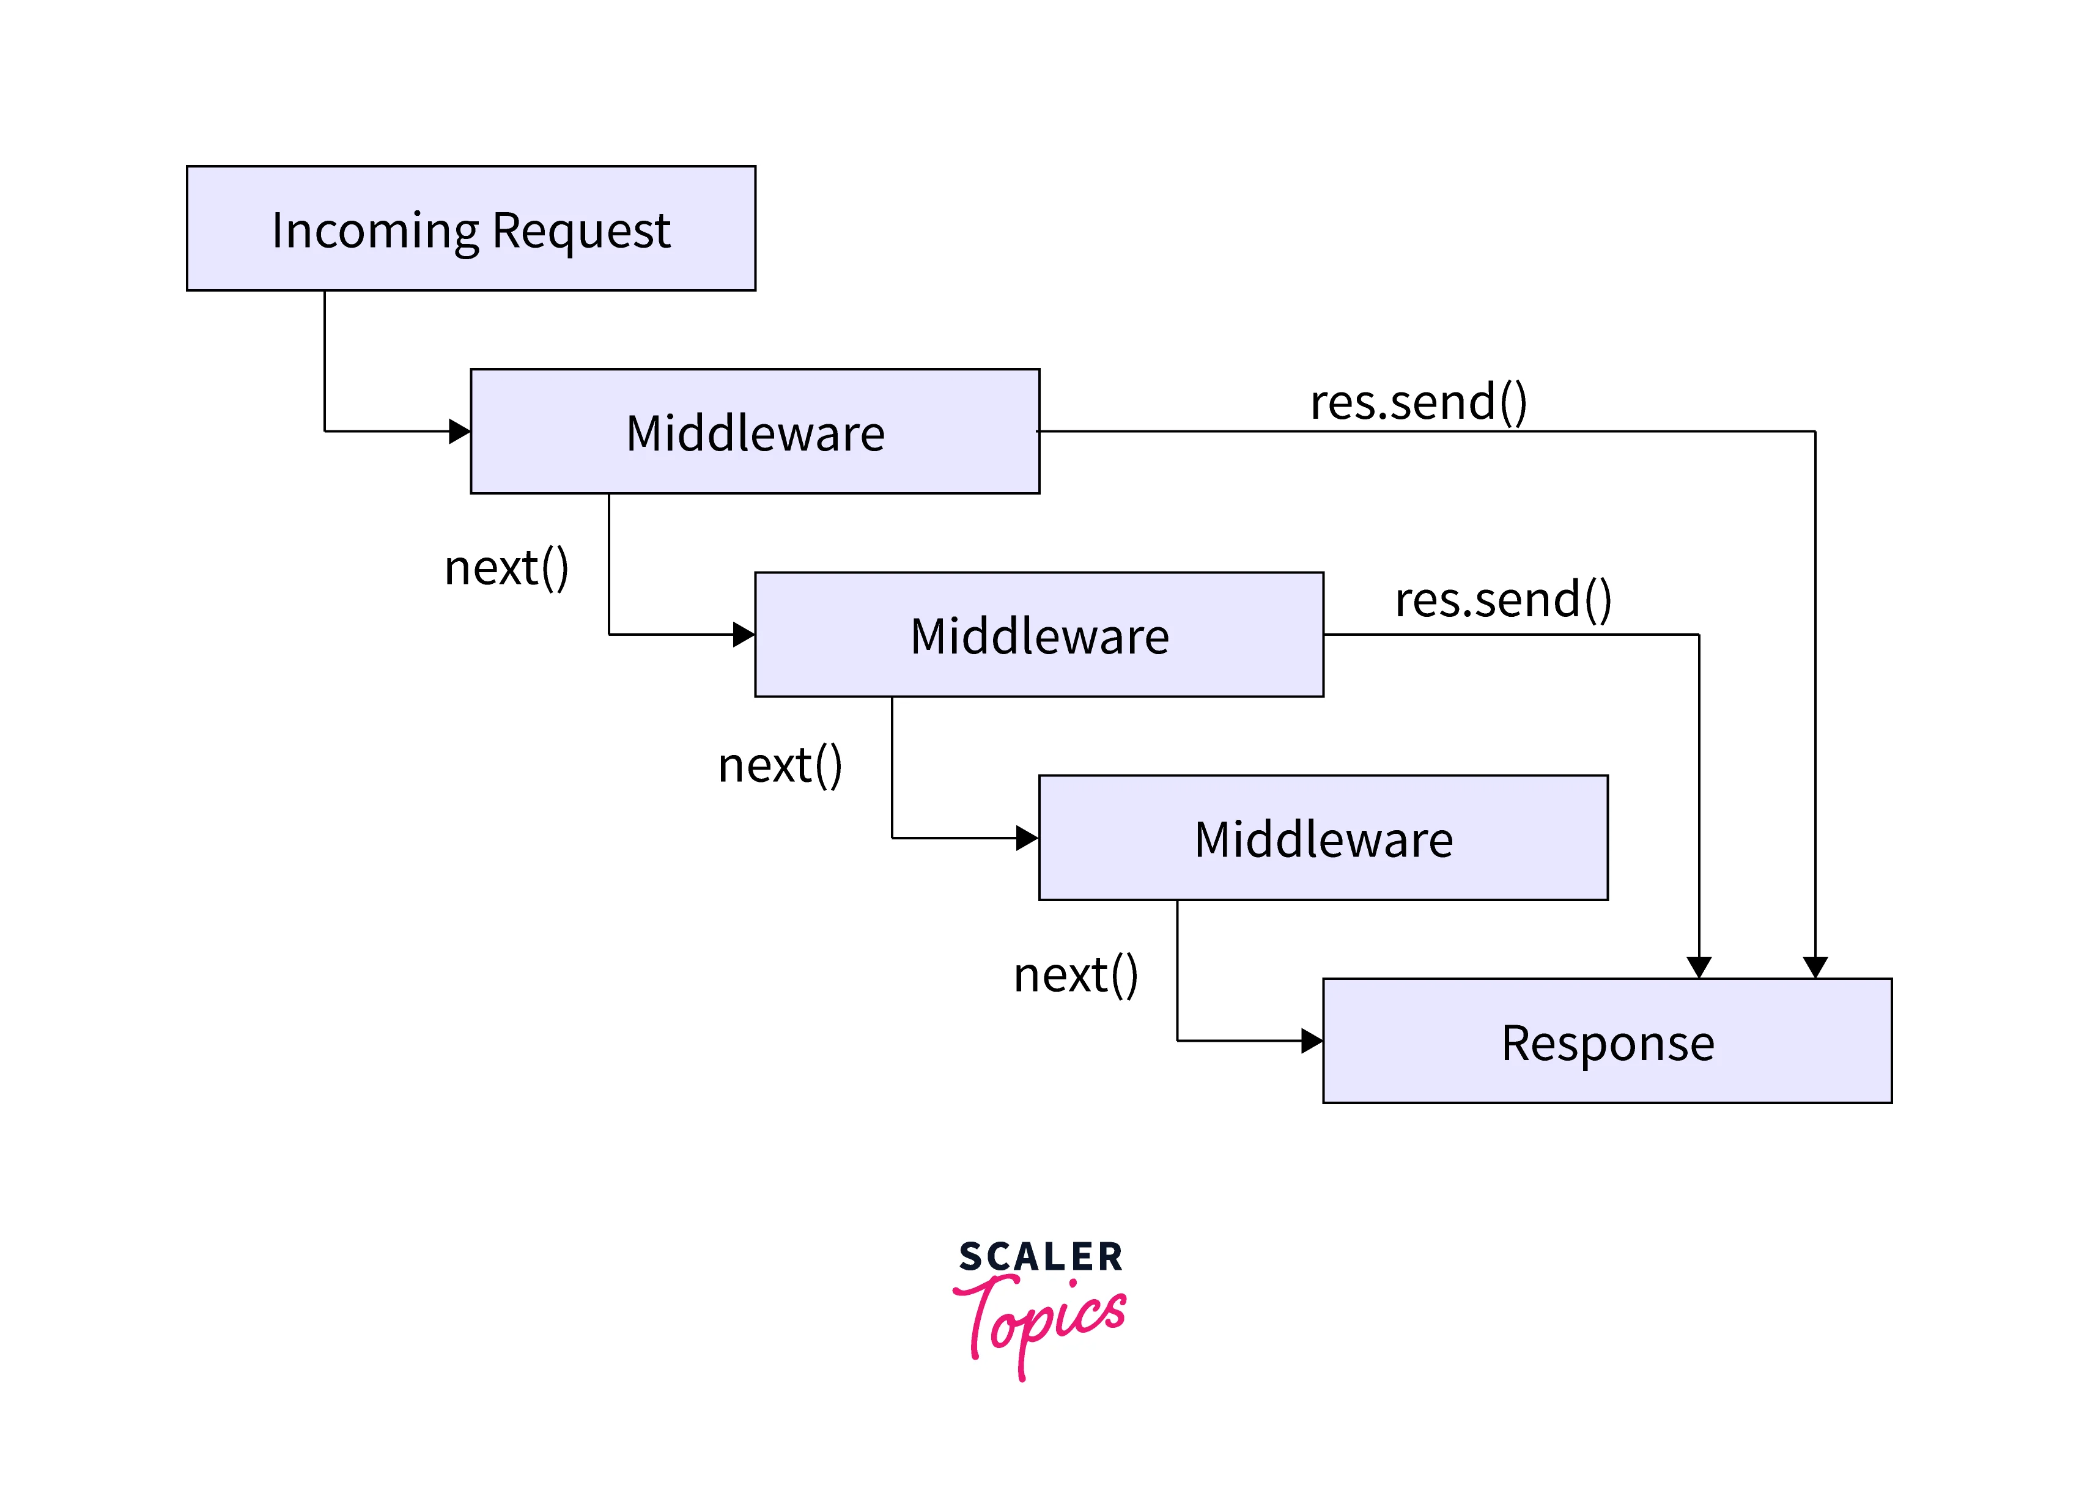
Middleware Chain

Slide 3
Request Pipeline
Request
Body parsing
CORS
Authentication
Authorization
Caching
Error handling
Response

Slide 4
CORS
Cross-Origin Resource Sharing
Same Origin Policy
Security feature to prevent web pages from making requests to a different domain for security reasons
Cross Origin Requests
Sometimes we must access APIs or resources hosted on different domains

Slide 5
Authentication
Authorization

Slide 6



Response Caching
First request
request to server
check in cache
save in cache
Subsequent requests

Slide 7
Exception Handler
Exception Middleware
error
MW
MW
error
error
MW
action
error

